Slide 1
Social Media Addiction & Adolescents
Yu, Adrian
November 30, 2022
FIQWS 10108
Professor C. Rodwell

Slide 2
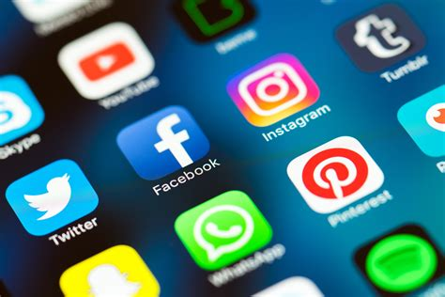
Overview
In this presentation, I will be discussing what social media addiction is as well as some social media stats. Additionally, both positive and negative aspects, its effects, and ways to reduce social media usage or consumption.

Slide 3
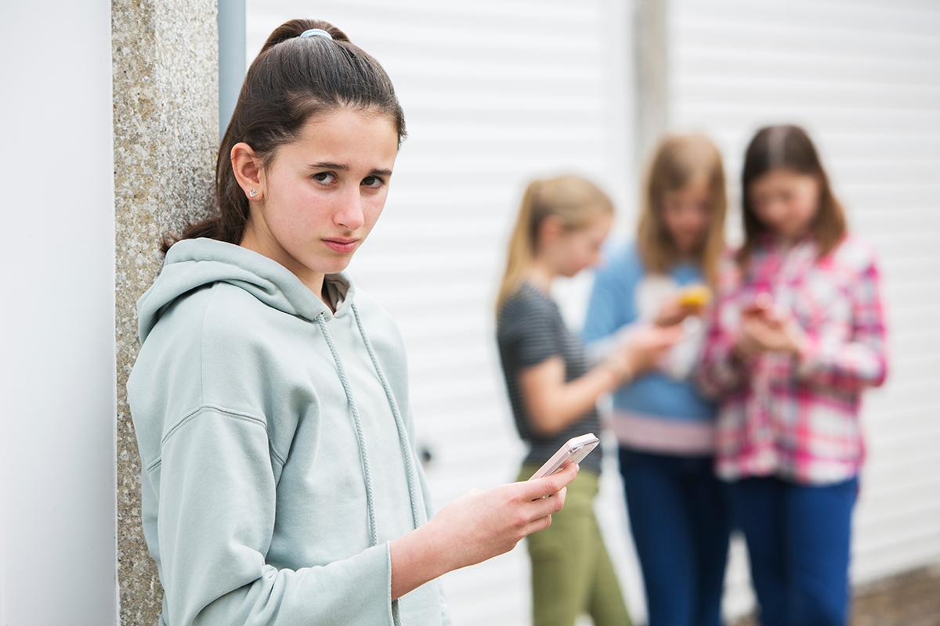
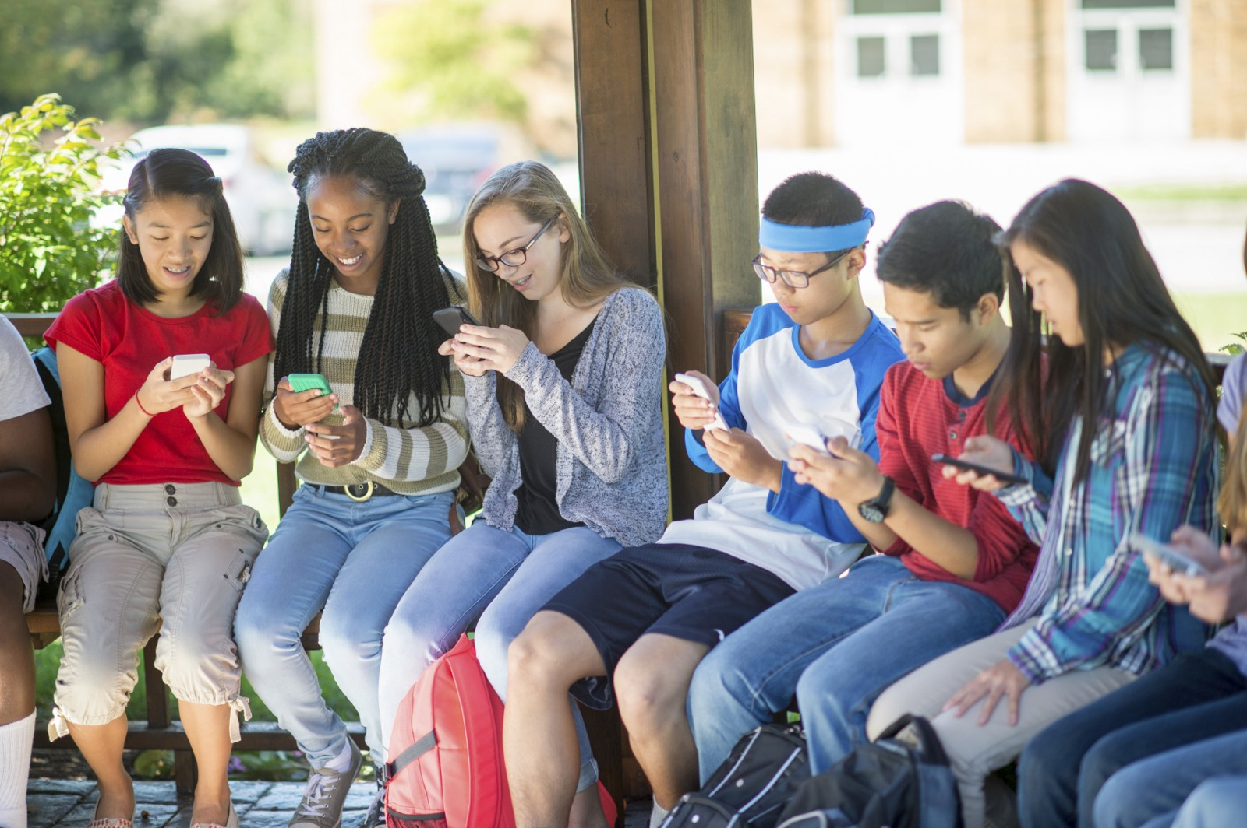
Agenda
1. What is Social Media Addiction?
2. Positive Aspects
3. Negative Aspects
4. Social Media Statistics
5. Effects & Reducing S.M. Consumption

Slide 4
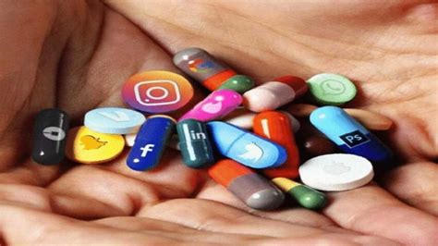
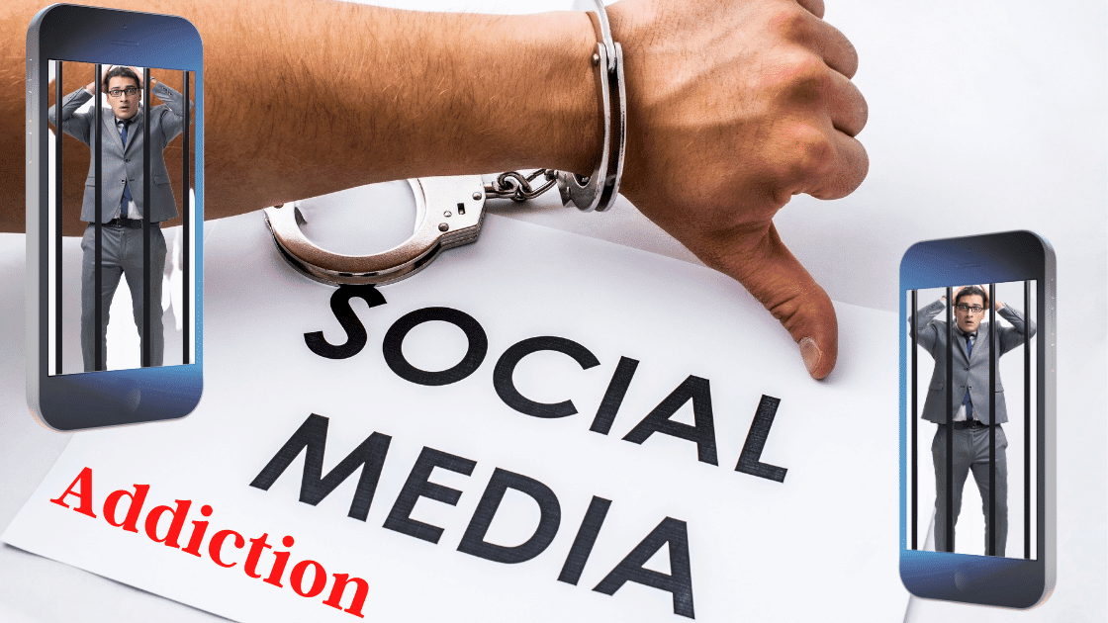
What is Social Media Addiction?
According to the Addiction Center, social media addiction is defined as, “a behavioral addiction that’s characterized as being overly concerned about social media, driven by an uncontrollably urge to log on to or use social media, and devoting so much time and effort to social media that it impairs other important life areas.”

Slide 5
Positive Aspects of Social Media
Build relationships and staying connected: Communicate and share content with users around the world (ex: Instagram or Snapchat)
Education: Users can watch videos/tutorials or learn to do new things to adapt skills leading to future career goals (ex: YouTube)
Voicing Own Opinions: Helps build confidence, spread positive/important messages (ex: favorite artists/music)
News Spreading: Keeps users informed about important events or crises (ex: natural disasters)

Slide 6
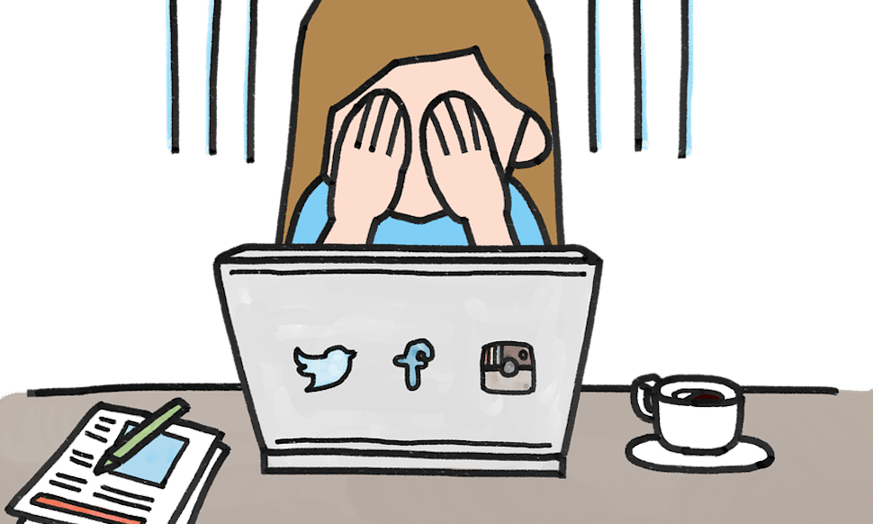
Negative Aspects of Social Media
Low Self Esteem: Users get influenced by celebrity photos and judge/compare themselves (ex: women in bikinis or men with abs/six packs)
Cyberbullying: A user may get lots of hate for something for their opinions or appearance, then be bullied because of it, leading to hurt themselves or worse, death
Sleeping Problems: Spending too much time on social media can lead to reduced sleep

Slide 7
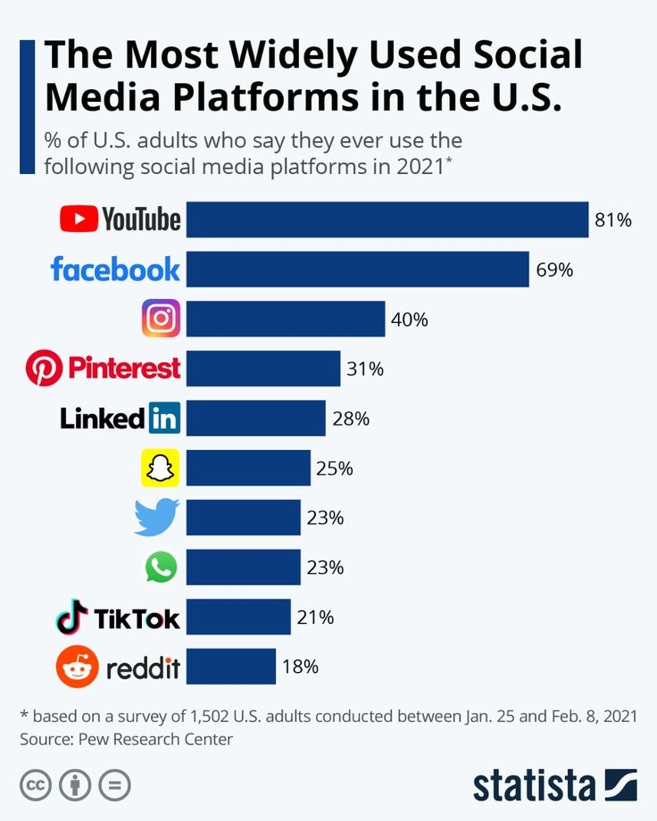

Slide 8
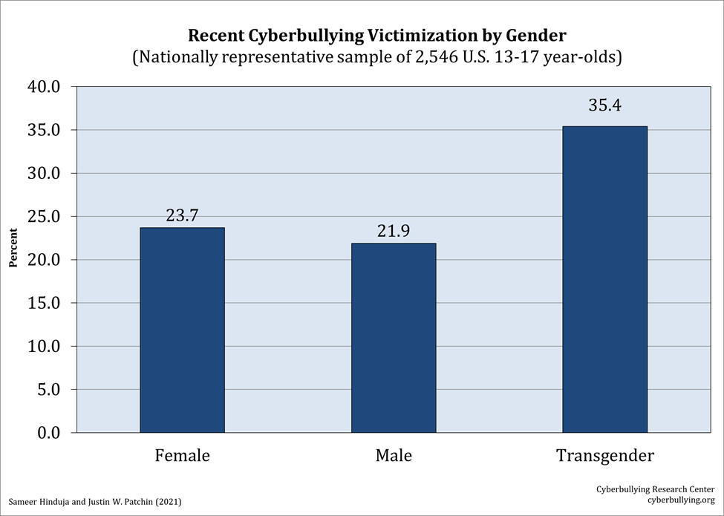

Slide 9
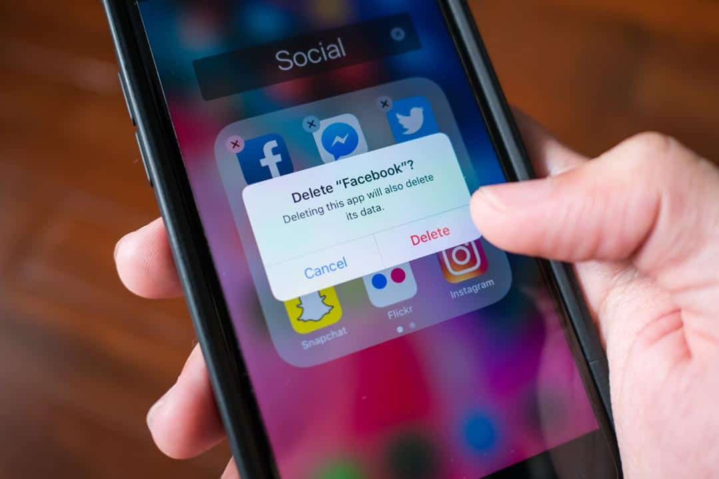
Reducing Social Media Consumption
Turn off notifications
Delete media applications (ex: Instagram, TikTok, YouTube, etc)
Utilize the screen time feature for devices
Put phone or device elsewhere instead of your bedroom
Use the Night Light (iPhone, iPad, macOS, Windows computers) or Blue Light Filter (Android phones and tablets) feature
Turning your phone to greyscale mode (removing all colors from your screen)

Slide 10
Sources
Positives: https://www.kubbco.com/13-positive-effects-of-social-media-on-our-society-today/
Negatives: https://www.makeuseof.com/tag/negative-effects-social-media/
Reducing SM Consumption: https://unscreen.org/how-to-reduce-social-media-use/
Social Media Definition: https://www.addictioncenter.com/drugs/social-media-addiction/
Oberlo Statistics: https://au.oberlo.com/blog/social-media-marketing-statistics
Cyberbullying Chart: https://cyberbullying.org/cyberbullying-statistics-age-gender-sexual-orientation-race
SM Platforms (2021): https://www.localgold.com/2021/04/12/social-media-platforms/

